Slide 1
Smart Community Health Monitoring and Early Warning System for Water-Borne Diseases in Rural Northeast India
CSE7302- University Project
Review-3
Batch Number: COM_61
Under the Supervision of,
Ms. Sumita Guddin
Assistant Professor
School of Computer Science and Engineering
Presidency University
Names | Roll Number
Swati S Patilkulkarni | 20221COM0148
Preeti S Patilkulkarni | 20221COM0142
Name of the Program: COM
Name of the HoD: Dr. Gopal Krishna Shyam
Name of the Program Project Coordinator: Ms. Sumita Guddin
Name of the School Project Coordinators: Dr. Sampath A K , Dr. Geetha A

Slide 2
Content
Abstract
Problem Statement
Objectives
Literature Survey
Existing methods and drawbacks
Proposed System
Methodology
Architecture
Modules
Software and Hardware Requirements

Slide 3
ABSTRACT
Water-borne diseases such as diarrhea, cholera, and typhoid are major health issues in rural areas due to unsafe water and poor sanitation. Existing monitoring systems are mostly manual and reactive, leading to delayed outbreak detection. This project proposes a Machine Learning-based early warning system to predict disease risk at the village level.
The system uses factors like season, rainfall, water source, and disease cases to analyze patterns and forecast outbreaks. Machine learning models such as Logistic Regression and Random Forest are applied to classify risk into Low, Medium, and High levels.
This approach enables early detection and helps healthcare authorities take preventive measures to reduce the spread of diseases.

Slide 4
PROBLEM STATEMENT
Water-borne diseases are highly prevalent in rural areas due to unsafe drinking water and poor sanitation facilities. Current health monitoring systems rely on manual data collection and are mostly reactive, leading to delays in identifying disease outbreaks.
There is no effective system to predict disease risk at the village level in advance. This results in late response and increased spread of infections, affecting public health significantly.

Slide 5
OBJECTIVES
To analyze village-level health and environmental data
To identify the relationship between water conditions and disease occurrence
To develop a Machine Learning model for disease prediction
To classify disease risk into Low, Medium, and High levels
To provide an early warning system for preventive action

Slide 6
Literature Survey
WHO (2023): Emphasized early detection of water-borne diseases
IEEE (2022): ML-based disease outbreak prediction
Springer (2021): Data analytics in public health monitoring
Elsevier (2020): Impact of water contamination on disease spread
MDPI (2024): Machine learning for water quality prediction
Research Gap: Most studies focus on urban or historical data and lack village-level early warning systems.

Slide 7
EXISTING METHODS & DRAWBACKS
Existing Methods
Manual health monitoring and surveys
No automation in prediction
Analysis based on historical data
Drawbacks
Time-consuming process
Reactive approach (action taken after outbreak)
Delayed detection of disease outbreaks
No real-time or village-level prediction

Slide 8
PROPOSED SYSTEM
This project proposes a Machine Learning-based Smart Community Health Monitoring and Early Warning System to predict water-borne disease risk at the village level.
The system collects and analyzes data such as season, rainfall, water source, and disease cases. Machine learning models are applied to identify patterns and predict the likelihood of disease outbreaks.
The output is classified into three risk levels: Low, Medium, and High, enabling early warning and timely preventive action by healthcare authorities.

Slide 9
METHODOLOGY
The proposed system follows a step-by-step process to predict water-borne disease risk:
Data Collection: Collect village-level data including season, rainfall, water source, and disease cases.
Data Preprocessing: Clean the data, handle missing values, and convert it into a structured format.
Feature Selection: Select important factors that influence disease spread, such as environmental and health indicators.
Model Training: Train Machine Learning models like Logistic Regression and Random Forest using the dataset.
Prediction & Classification: The trained model predicts disease risk and classifies it into Low, Medium, or High levels.

Slide 10
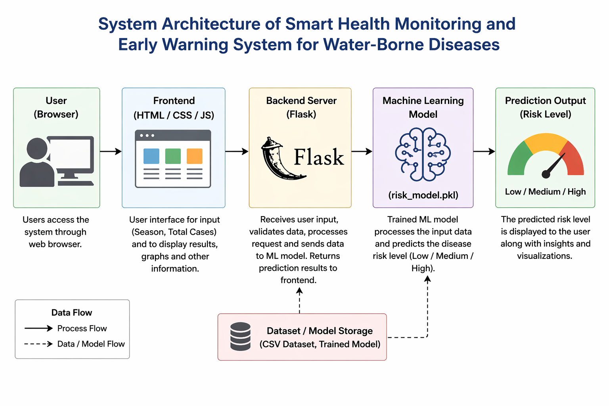
SYSTEM ARCHITECTURE

Slide 11
MODULES
1. Data Collection Module
Collects village-level data such as season, rainfall, water source, and disease case counts from health records and environmental sources.
2. Data Preprocessing Module
Cleans the collected data by removing missing or incorrect values and converts it into a structured format suitable for analysis.
3. Disease Prediction Module
Applies Machine Learning models like Logistic Regression and Random Forest to analyze data and predict disease risk.

Slide 12
Cntd
4. Risk Classification Module
Classifies the predicted output into three categories:
Low Risk
Medium Risk
High Risk
5. Visualization & Alert Module
Displays the results in a simple format and generates alerts to provide early warning for preventive action.

Slide 13
HARDWARE & SOFTWARE REQUIREMENTS
Software
Python
Pandas, NumPy
Scikit-learn
Streamlit / Flask
Hardware
Laptop / PC
Minimum 8 GB RAM

Slide 14
Github Link
The Github link provided should have public access permission.
Github Link
https://github.com/swati787/Early-Warning-System-for-Water-Borne-Diseases-in-Rural-Northeast-India

Slide 15
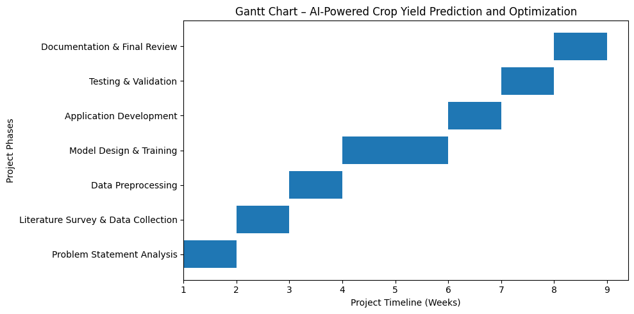
Timeline of the Project (Gantt Chart)

Slide 16
References (IEEE Paper format)
[1] B. Nemade and D. Shah, “IoT-based automated system for water-related disease prediction using ML classifiers,” Recent Advances in Computer Science and Communications, vol. 19, 2026.
[2] A.Mohammadpour, “Advanced water quality assessment using machine learning,” ScienceDirect, 2025.
[3] I.Villanueva-Miranda et al., “Artificial intelligence in early warning systems for infectious diseases,” PMC (PubMed Central), 2025.
[4] F. Abbas, “Machine learning models for water quality prediction,” Water (MDPI), vol. 16, no. 7, 2024.
[5] I. Kaur, “Water Quality Assessment using Machine Learning,” AJWEP Journal, 2024.

Slide 17
References (IEEE Paper format)
[6] R. Baena-Navarro, “Intelligent prediction and continuous monitoring of water quality using ML and IoT,” Water (MDPI), vol. 17, no. 1, 2025.
[7] “Machine learning and explainable AI for prevention of waterborne cryptosporidiosis and giardiosis,” ScienceDirect, 2024 (XGBoost & RF models).
[8] “Machine learning and spatio-temporal analysis of meteorological drivers for waterborne diseases,” PLOS Neglected Tropical Diseases, 2024.
[9] “Assessment of ML for predicting weather-sensitive waterborne diseases,” Frontiers in Artificial Intelligence, 2025.
[10] “Machine learning-based classification of waterborne diseases using advanced analytics,” ResearchGate, 2025.

Slide 18


